Slide 1
The 8 Step Path of Yoga
Did Prince Gautama have knowledge of this system?
Yoga is an ancient tradition as part of the belief system and practices of Hinduism
It is likely that during his studies and practices of asceticism that Gautama would have encountered Yoga
No development of knowledge occurs in a vacuum and each is enriched by its prevailing environment
There is a theory that Jesus of Nazareth encountered Buddhism during his early adult life, before he began his teaching

Slide 2
£
What do we mean by Yoga?
Yoga postulates that it’s aim is to reach the state known as samadhi.
In everyday language fulfilment is the best word, we wish to move towards fulfilment
Svatmarama in the Yoga Hathapradipika wrote “I bow to the Almighty who taught the lore of Hatha Yoga, which is held in high esteem, as if it were a flight of steps for him who looks forward to climbing the highest peak of Rajayoga”.
In Hatha Yoga the body is cleansed, the nadis are purified and energy blocks are released prior to the practice of asana, pranayama and mudra; thus it is a method of preparing the system for spiritual awakening.
Patanjali begins the classical 195 Yoga Sutras with “Yoga is the restriction of fluctuations of consciousness”
In other words asana, pranayama, pratyahara, dharana, dyyana, samadhi and other aspects of Hatha yoga are inextricably bound up with the deepening control of consciousness.

Slide 3
What do we mean by Yoga?
There are many branches of Yoga e.g. Raja, Karma, Bhakti, Hatha, Mantra etc.
Here in Britain people seem to think of Hatha Yoga as the default system of Yoga and many are unaware of the other types.
It is my belief that the easy visibility of the postures and the nature of celebrities “doing Yoga” on television has led to the situation of Yoga almost being downgraded to a system of slow gymnastics.
To perform exercises under the name of Yoga is as absurd as to mistake weeding for the total approach to gardening.
In each case the thing performed is a small part of the whole, i.e. part of something does not achieve like the whole does

Slide 4
What do we mean by Yoga?
Yoga seeks to remedy the conditioning which stands between people and their own natural state. It does not mean that such a goal can be achieved by asanas or even by the correct regulation of breathing – a form must be found in which the total concept of Yoga can be got across: the understanding of the process of integration which is life
The word Yoga means a yoke, or a joining together, a completeness of body, breath, mind and spirit
Yoga is a whole life system including moral and ethical considerations

Slide 5
Why Yoga
In relation to Yoga we need to remedy the condition we have got ourselves into, be it disease, behavioural problems, mental problems, imbalance, pain or suffering. We basically need to restore the body and mind to their natural state.
Is Yoga more than a means to make us feel better? Maybe we could continue to debate this and conclude that yes it could be.
People need Yoga since few people have achieved balance, harmony or union in body, mind and spirit or reached the state of Samadhi/Bliss.

Slide 6
The Path of Yoga
Aparigraha non-coveting, non-greed, generosity
As a human with free will we can choose to take the path of morality
Bramacharya abstinence, moderation
Asteya
non-stealing
Satya truthfulness in mind, word and action
(1) YAMAS:-
self restraint, morals and ethics
Ahimsa compassion non-violence, non-harming to any living creature
SELF
HERE AND NOW
© Dr Susanne Swanwick

Slide 7
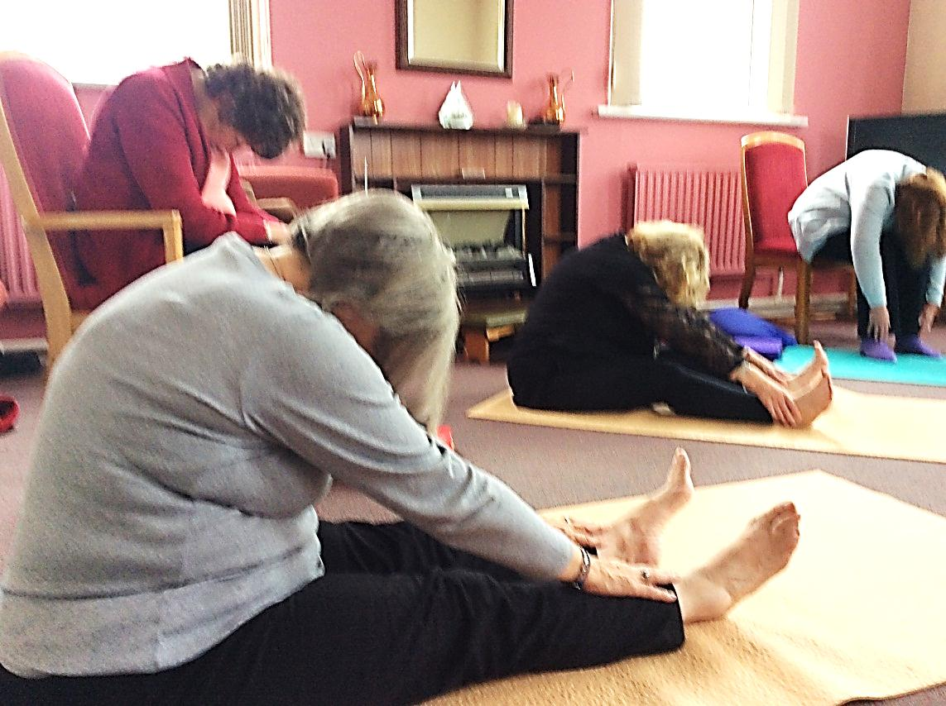
The Path of Yoga
Ahimsa compassion non-violence, non-harming to any living creature
Ahimsa, compassion to self whilst practising Paschimottanasana
© Dr Susanne Swanwick

Slide 8
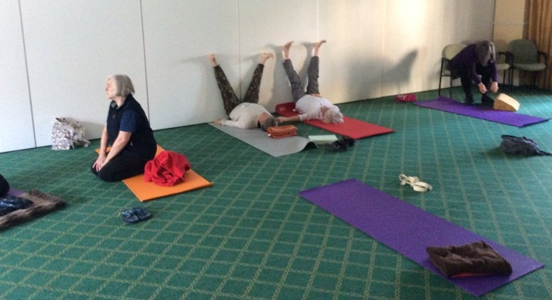
The Path of Yoga
Satya truthfulness in mind, word and action
Participants showing truthfulness about their own physical ability during a supported shoulder stand
© Dr Susanne Swanwick

Slide 9
The Path of Yoga
Saucha purity, cleanliness of mind body heart environment
(2) Niyamas:-
Self-observances, conduct towards oneself
Santosha contentment
Tapas discipline or austerity
Svadhyaya study, intellectual and of inner-nature, self realisation
Iswara pranidhana contemplation on spirit and respect for all forms of life
As a human with free will we can choose to follow the Niyamas
© Dr Susanne Swanwick

Slide 10
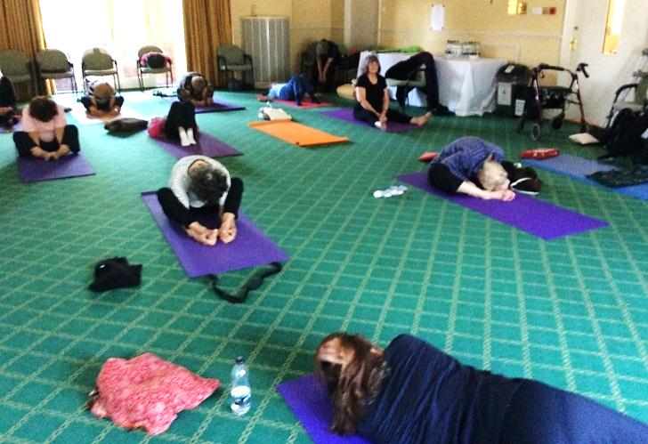
The Path of Yoga
Santosha contentment
A gentle forward bend by our flexible friends in the remedial group being content with as they are now
© Dr Susanne Swanwick

Slide 11
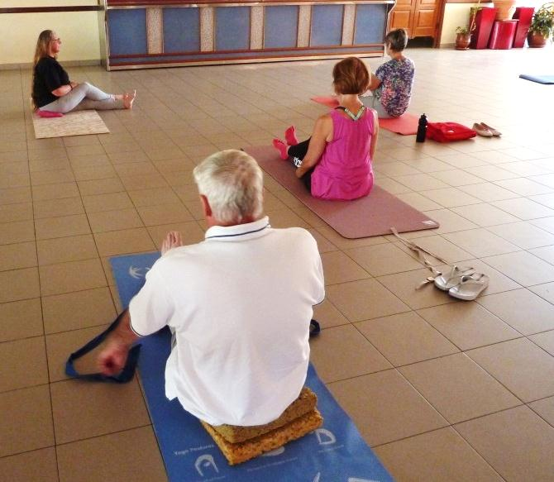
The Path of Yoga
(3) Asana seat:- postures practised to enable sitting for extended periods, a position which is comfortable and steady
Preparing for the half spinal twist, note some sat on their mats, some on blocks and some on chairs to practice a modified posture
© Dr Susanne Swanwick

Slide 12
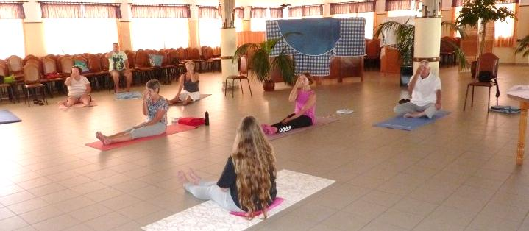
The Path of Yoga
(4) Pranayama breath interruption, expansion of the breath of life beyond limitations of body and mind
No they haven’t all got their fingers up their noses, they are practising alternate nostril breathing! Pranayama
© Dr Susanne Swanwick

Slide 13
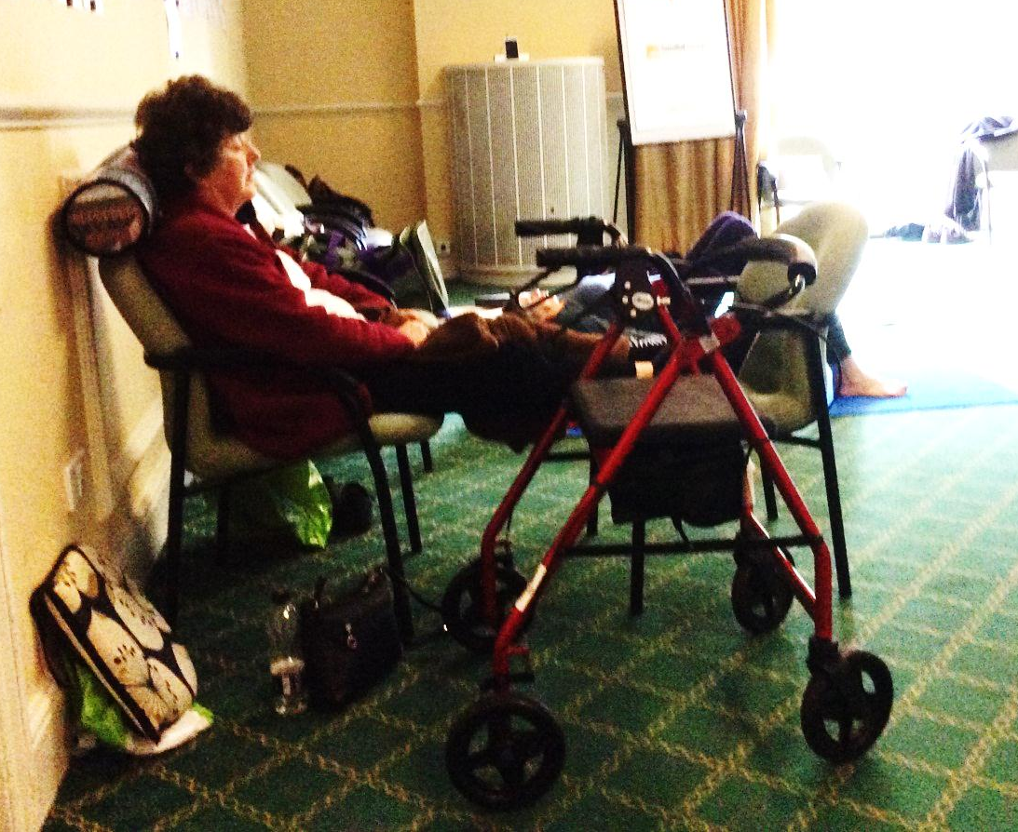
The Path of Yoga
(5) Pratyahara withdrawal of the senses from the outside environment, find inner contentment
Asana is a stable posture for withdrawal of the senses, pratyahara, in preparation for meditation
© Dr Susanne Swanwick

Slide 14
The Path of Yoga
(8) Samadhi identification with pure consciousness, enlightenment
Bliss £
As a human with free will we can hope that by following the Yogic path we may reach beyond the withdrawal of our senses and reach the ultimate goal
(7) Dhyana meditation expansion of consciousness
(6) Dharana concentration strengthens the mind
(5) Pratyahara withdrawal of senses from the outside environment, find inner contentment
© Dr Susanne Swanwick

Slide 15
The Path of Yoga
Saucha purity, cleanliness of mind body heart environment
Santosha contentment
Tapas discipline or austerity
Svadhyaya study, intellectual and of inner-nature, self realisation
Niyamas:-
Self-observances, conduct towards oneself
Aparigraha non-coveting, non-greed, generosity
Samadhi identification with pure consciousness, Enlightenment
Bliss £
Iswara pranidhana contemplation on spirit and respect for all forms of life
Dhyana meditation expansion of consciousness
Bramacharya abstinence, moderation
Asana seat: postures practised to enable sitting for extended periods, a position which is comfortable and steady
Asteya
non-stealing
Dharana concentration strengthens the mind
Pratyahara withdrawal of senses from the outside environment, find inner contentment
Satya truthfulness in mind, word and action
Pranayama expansion of the breath of life, beyond limitations of body and mind
Ahimsa compassion non-violence, non-harming to any living creature
YAMAS:-
self restraint, morals and ethics
SELF
HERE AND NOW
© Dr Susanne Swanwick

Slide 16
Thank you to:-
The ancient sages who developed the path of Yoga
Each person who has taught me and guided me on my Yogic path
The Buddha for his teachings
And the world-wide sangha
You – for listening
I leave you with love and peace –
And hand over to Geoff

